Slide 1
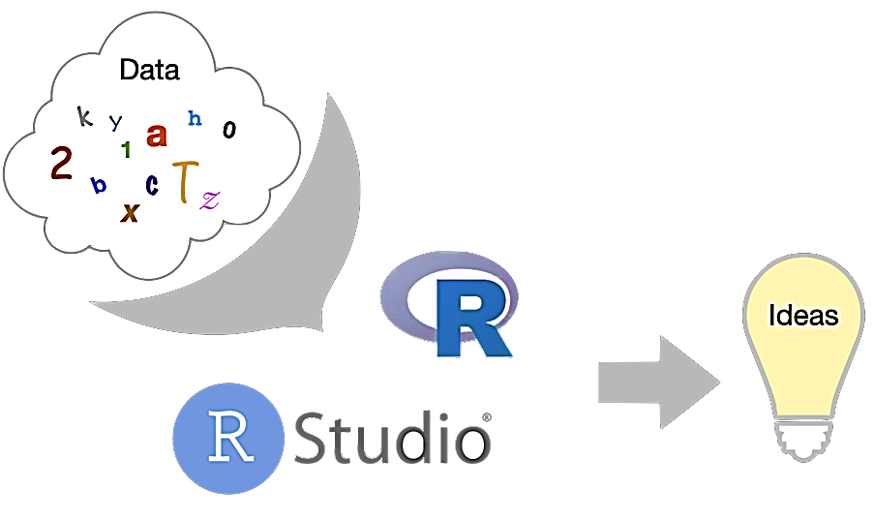
Intro To Data Analysis in R
Presenter: Paulina Mensah
(Aspiring Expert Data Carpenter)

Slide 2
Contents
Brief Overview of R
Why learn R
Variables and Data Types
Operators
Fundamental Data Structures in R
References and Resources
Main Studio Session!

Slide 3
Brief Overview of R
The name of R came from the names of its core developers, Robert Gentleman, and Ross Ihaka. It’s also a play on the name of it’s parent language: S. R’s semantics, however, is closer to that of Scheme, a functional programming language.
R is a functional programming language. Functions are first-class objects. This means that you can do anything with functions as you can do with any other R object. As a result, you are allowed to assign R functions to variables, store them in lists, pass them as arguments, and return them as a result of a function. . Everything that happens in R happens via a function call. Even assignment is really a function.
However, R is not a “pure” functional language. R has the stuff of imperative programming languages, such as loops and assignment. So it isn’t just a functional programming language.
To understand computations in R, two slogans are helpful:
Everything that exists is an object.
Everything that happens is a function call.
— John Chambers, quoted in Section 6.3 of Advanced R by Hadley Wickham
Notes:
. A functional programming language is “pure” if all functions act like math functions: for the same inputs (arguments) they always produce the same output (value). They cannot do assignment (except to local variables inside the function that are not visible to callers of the function), input, or output. They cannot use random numbers.
Syntax and semantics
In computer programming, syntax refers to the rules that dictate a language’s ‘spelling’ and ‘grammar,’ while semantics refers to how a language’s data or commands are presented.
R’s syntax was very similar to that of S in its early years. This made it easy for people using S-PLUS to change to R, which played a key role in R’s eventual popularity in academia. R’s semantics, however, is closer to that of Scheme, a functional programming language.

Slide 4
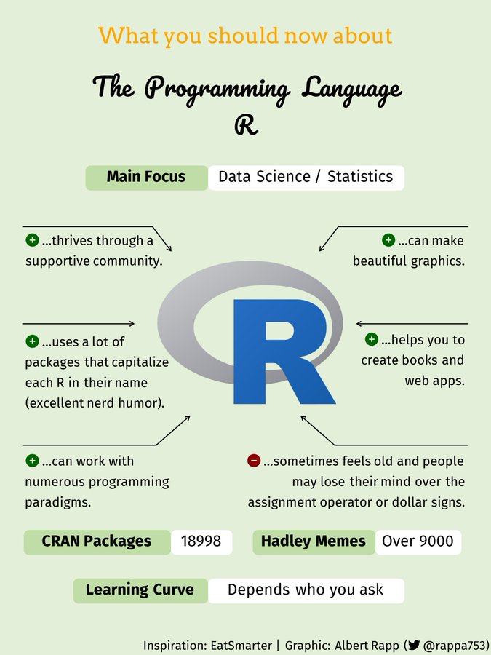
Big-name companies that use R in their tech stack:
Bank of America
Amazon
Facebook
JP Morgan
Google
Accenture
LinkedIn
IBM
Uber
Deloitte
The New York Times
Ford
HP
And many more…
Careers with R
Data scientist
Statistical engineer
Data analyst
R programmer
Data architect
Database administrator
Geo statistician
Researcher
Business intelligence
Financial analyst
Machine learning scientist
Quantitative analyst
Statistician
And more…
Notes:
R is a low-level programming language, which means a few different things, including that it’s closer to a machine language than a natural human language. This, combined with its syntactic quirks have given R a reputation for being difficult to learn.
There’s a trade-off here: R offers power, extensibility, and flexibility in droves but the ‘cost’ is a certain level of complexity.
ADVANTAGES
1. Excellent for Statistical Computing and Analysis
2. Open Source
3. Cross-platform compatibility (machine-independent)
4. Can do Data Cleansing, Data Wrangling, and Web Scraping
5. Using libraries like ddR or multiDplyr, R can process large data sets using parallel or distributed computing.
6. Compatible with other programming languages.
7. Used in machine learning
8. Can interact with databases.

Slide 5
Variables and Data Types
Data Types in R
Variables are simply names/tags you give to the values/contents stored in memory of the computer system that is running (executing) your code.
Rules in naming variables:
Your variable should not begin with a number e.g. 200var.
Your variable should only contain letters, numbers, dot, and underscore e.g. var_2.
Your variable should not start with underscore e.g. _var.
If your variable starts with a dot (.), it should not be followed by a number e.g. .2var
Type | Example
Integer | 186L
Numeric | 20.2
Character | “r lessons @ Resagratia”
Logical | TRUE
Complex | 20 + 2i
Raw | Values are displayed as raw bytes.
Notes:
Practice time: Let’s go assign the examples here to variables and check out their data types!

Slide 6
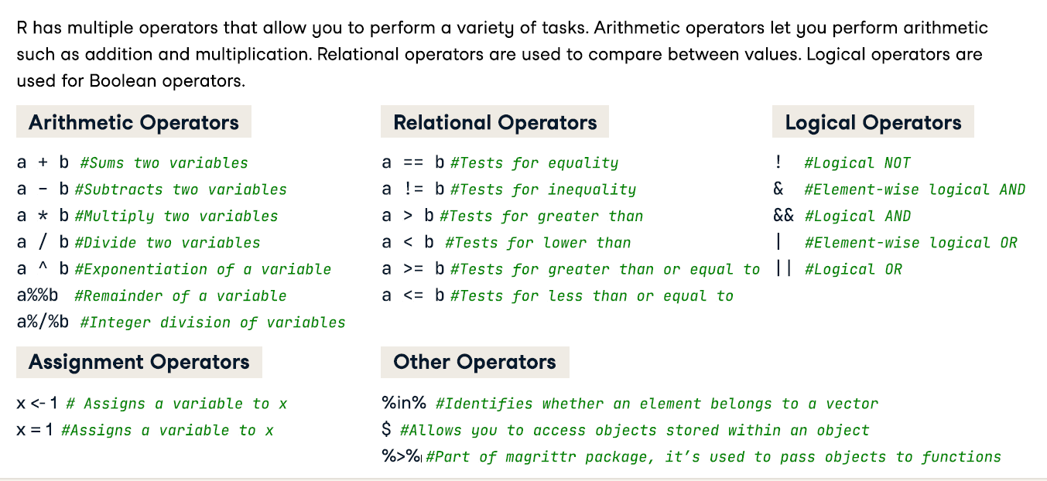

Slide 7
Fundamental Data structures in R
A data structure is a particular way of organizing data in a computer so that it can be used effectively. The idea is to reduce the space and time complexities of different tasks.
Vectors:
A vector is a one-dimensional data structure. c() is a built-in function that converts an item into a vector. A vector in R can only contain objects of only one data type.
Matrices:
Matrices are 2-dimensional structures that resemble a table, with rows and columns. Like vectors, every cell in a matrix has to have the same type. To create a matrix in R you use the function matrix().
Lists:
Lists in R can contain objects of various data types - other lists, vectors, matrices, and even functions. list() is the function that converts an item into a list.
Factors:
Factors are used to categorize the data and store it as levels. They are useful for storing categorical data. To create a factor, you use the function called factor(). The argument to this is the vector.
Data Frames:
This is made of rows and columns and can contain objects of various data types.
A data-frame must have column names and every row should have a unique name. Each column must have the identical number of items. Each item in a single column must be of the same data type. To create a dataframe you use the function data.frame().
Arrays **
Notes:
Practice time: Let’s go check out examples of these data structures in the Studio!
Arrays are the R data objects which store the data in more than two dimensions. Arrays are n-dimensional data structures. For example, if we create an array of dimensions (2, 3, 3) then it creates 3 rectangular matrices each with 2 rows and 3 columns. They are homogeneous data structures.

Slide 8
This is R. There is no if. Only how. - Simon Blomberg

Slide 9
References and Resources
Resources
Download R from the The Comprehensive R Archive Network (CRAN):
https://cran.stat.upd.edu.ph/
Download Rstudio:
https://www.rstudio.com/products/rstudio/download/
Cheatsheets from Rstudio:
https://www.rstudio.com/resources/cheatsheets/
More on Python vs R for Data Analysis:
https://www.datacamp.com/tutorial/r-or-python-for-data-analysis
Websites to explore further on R:
DataCamp
Hackerrank
R-bloggers.com
R-tutor.com

Slide 10
References
Stat 8054 Lecture Notes: R as a Functional Programming Language https://www.stat.umn.edu/geyer/8054/notes/functional.html#:~:text=Rhasthestuffof,orJavaorC++.
DataCamp R Cheatsheet
The R Language: an Overview https://dcode.hashnode.dev/the-r-language-an-overview?source=newsletter
R Data Types https://www.programiz.com/r/data-types
Data Structures in R Programming https://www.geeksforgeeks.org/data-structures-in-r-programming/

